Slide 1
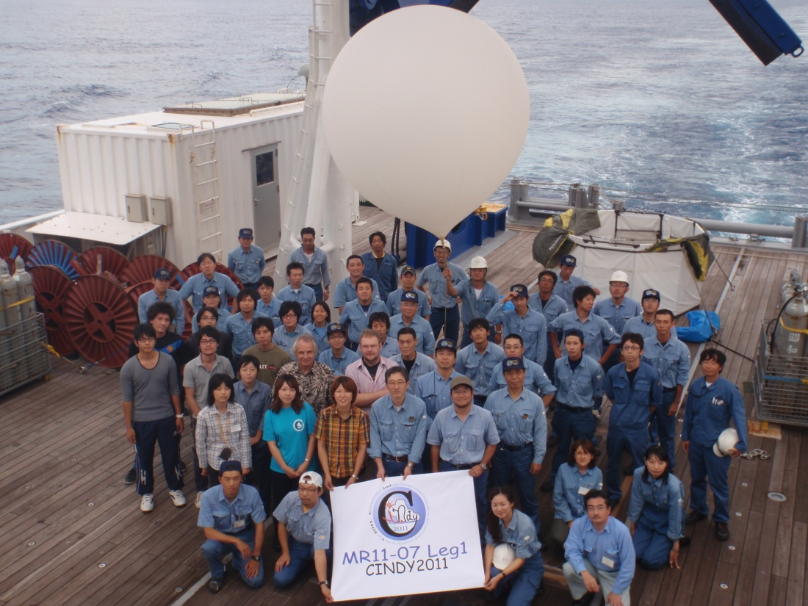

Slide 2
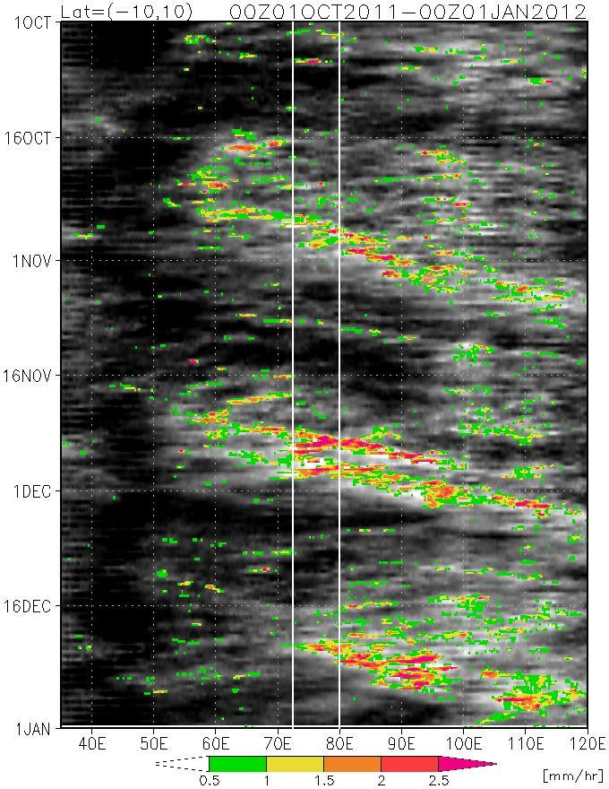
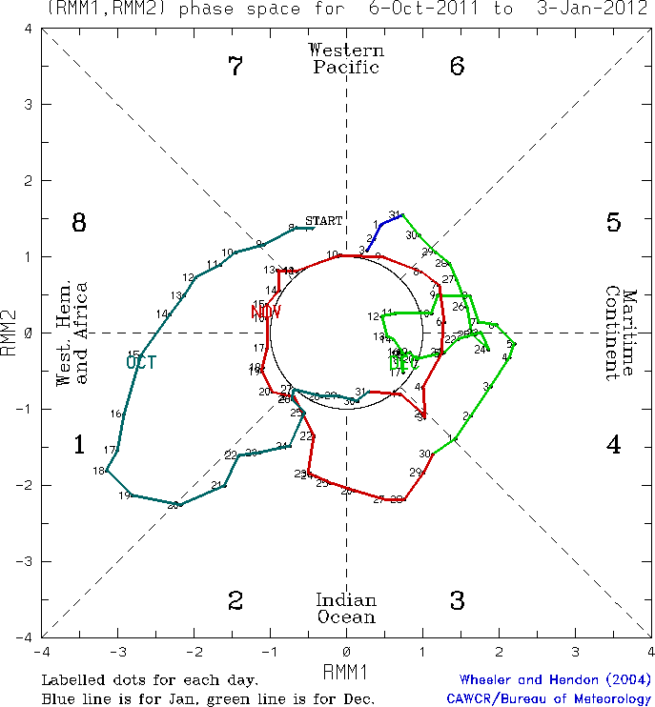
3 MJO events ?
10/1
OCT
DEC
11/1
12/1
NOV
1/1

Slide 3
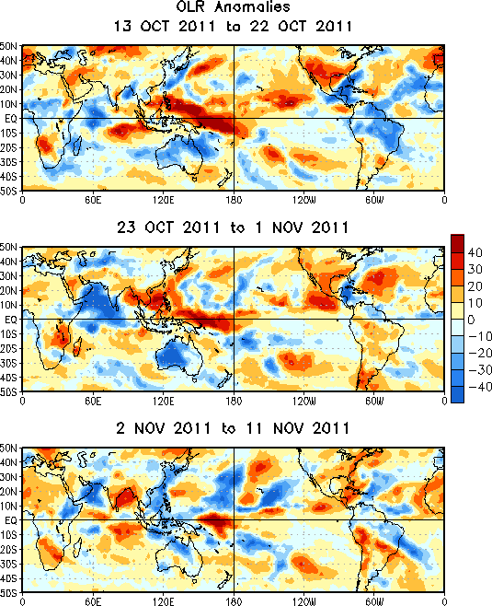

Slide 4
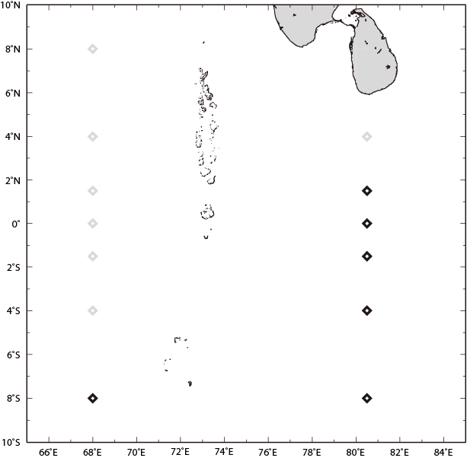

Slide 5
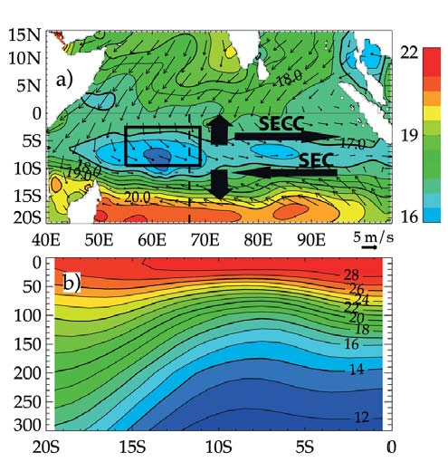
Surface winds and
0-300m temperature
Temperature along 67E
Vialard et al 2009

Slide 6
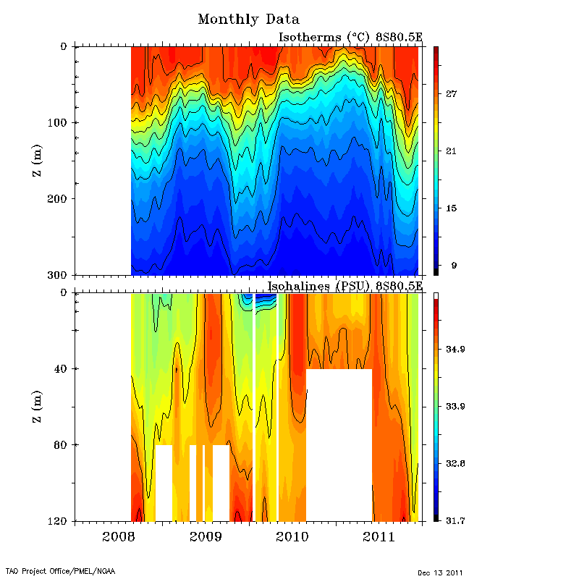
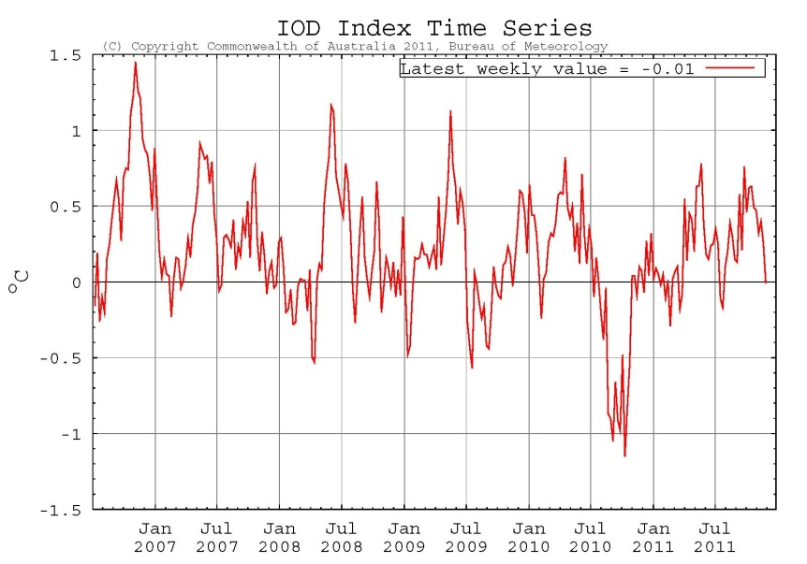
RAMA buoy

Slide 7
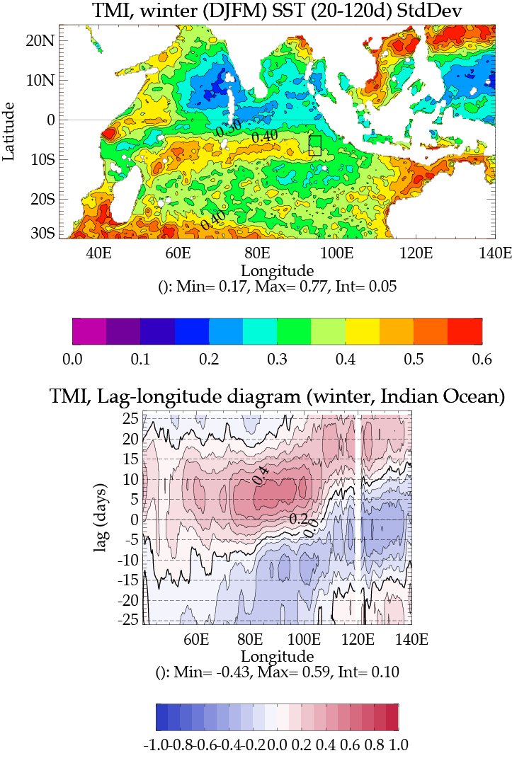
Indian Ocean SST Variability (20-120 days)
Observations
Sebastien Masson

Slide 8
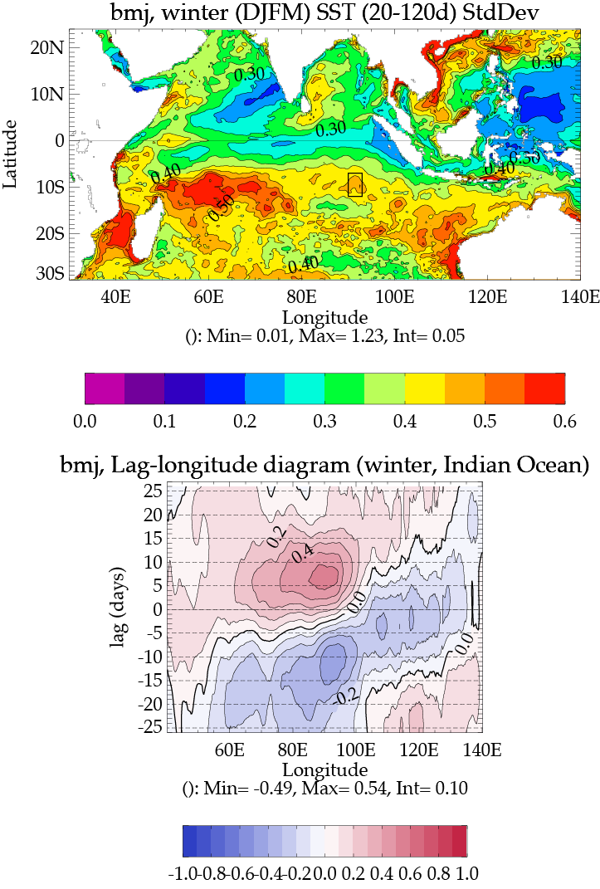
Indian Ocean SST Variability (20-120 days)
Observations
Model
Sebastien Masson

Slide 9
Questions to address:
What controls the SST and upper ocean heat content before, during and after an MJO event?
Processes affecting SST include surface fluxes, ocean vertical mixing, the diurnal cycle, advection of heat and Ekman pumping, seasonal cycle, ENSO, IOD.
How representative are the measurements taken during CINDY2011?
Need to know how the observed ocean response at 8S, 80E compares with other locations and MJO events.
What is the impact of the presence of the thermocline ridge and associated upper ocean variability on the initiation and development of MJO events?
Numerical experimentation with a regional coupled model.

Slide 10
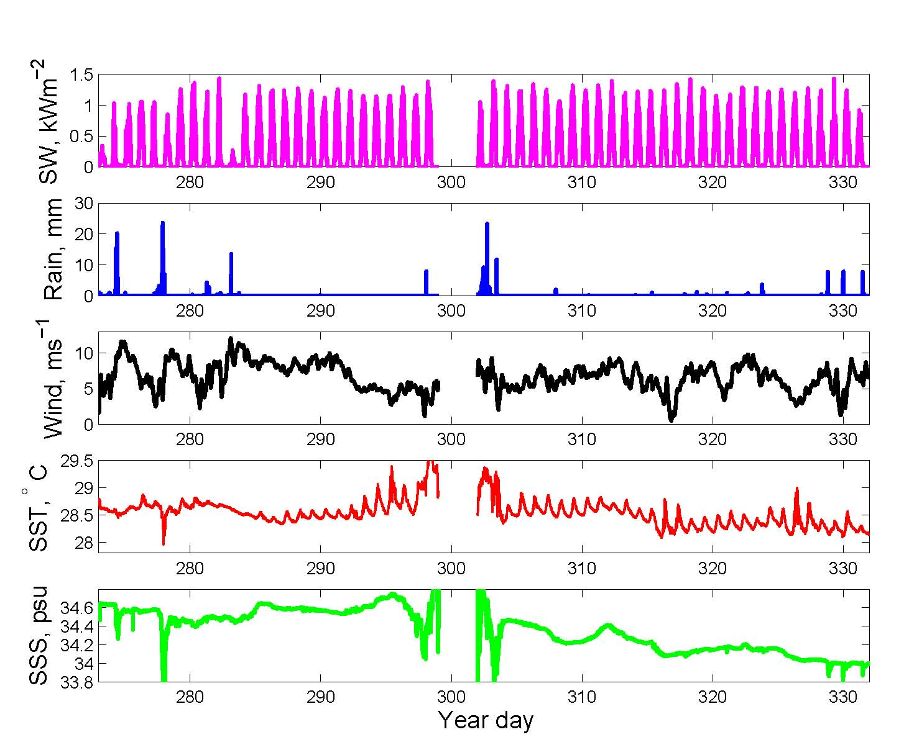

Slide 11
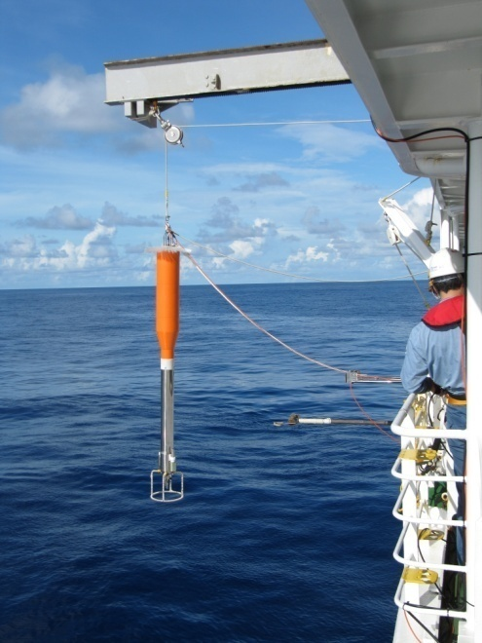
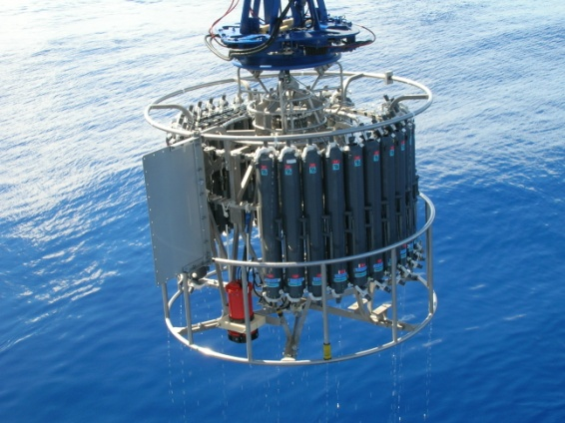

Slide 12
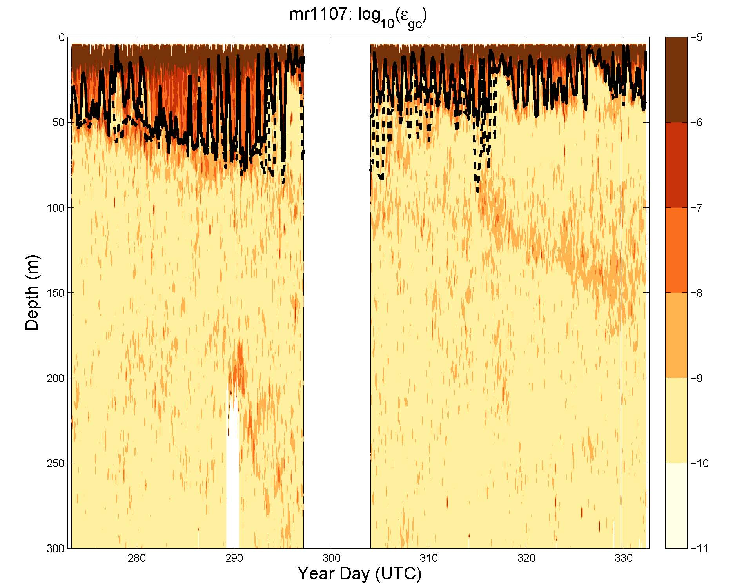

Slide 13
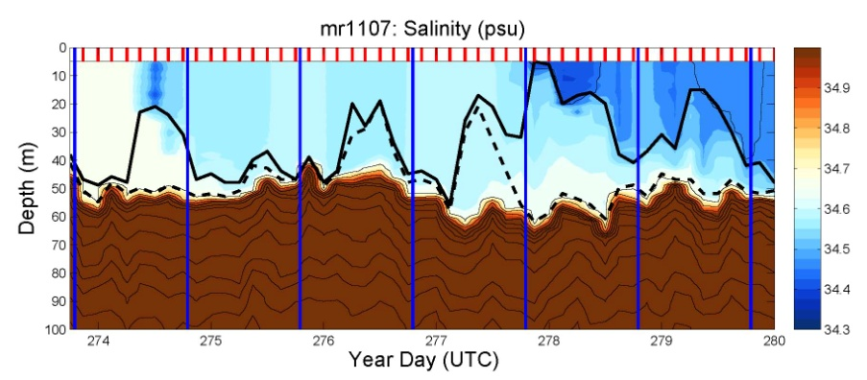
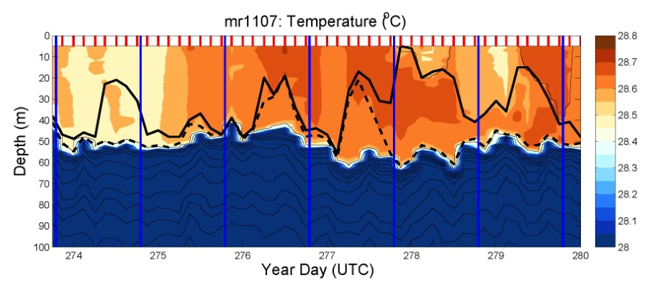
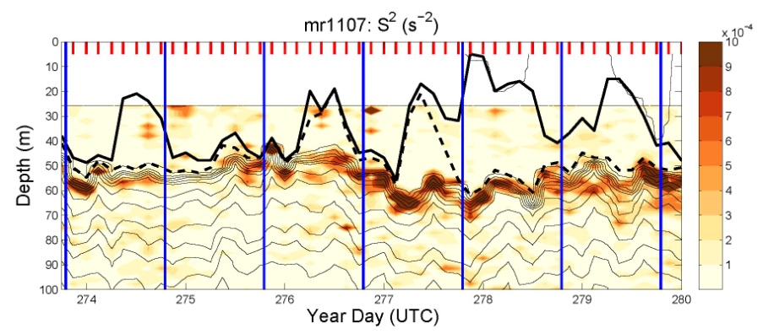
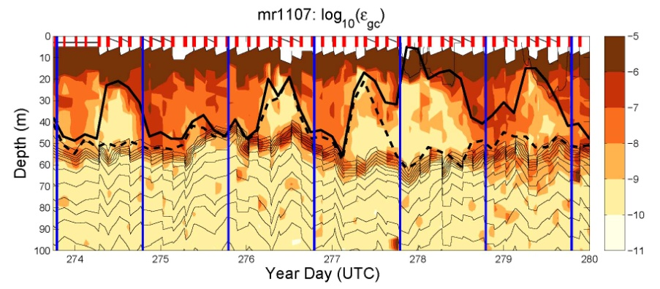
Salinity
Temperature
Shear
Turbulence

Slide 14
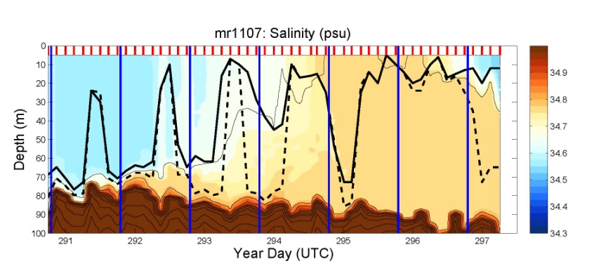
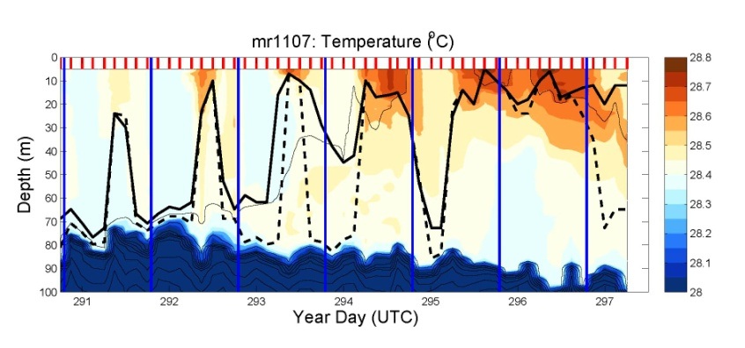
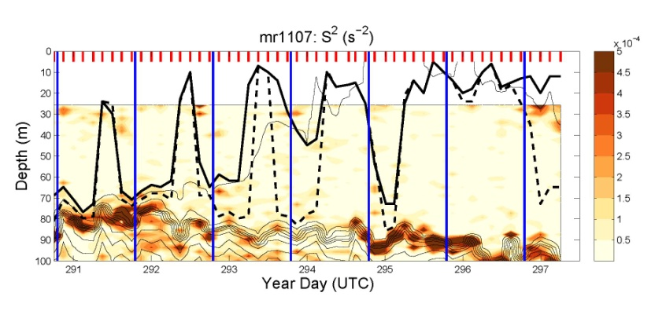
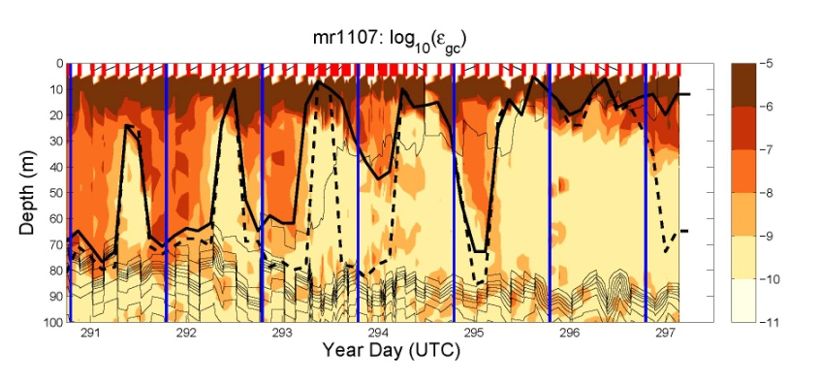
Salinity
Temperature
Shear
Turbulence

Slide 15
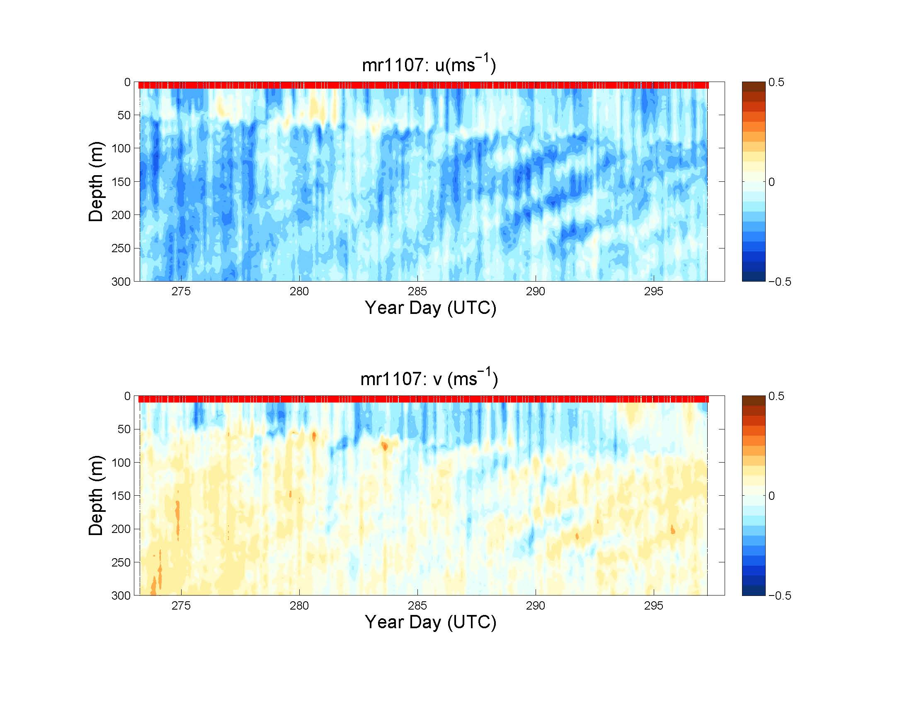

Slide 16
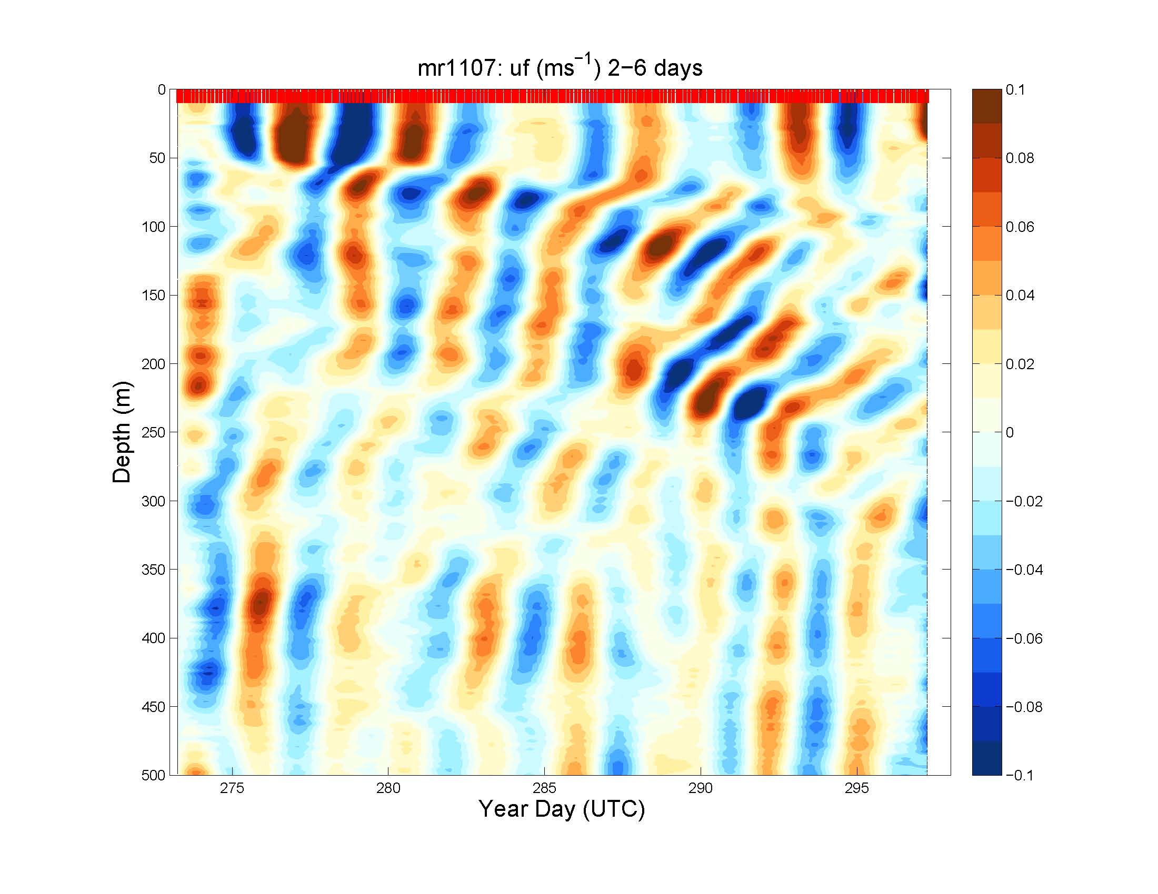

Slide 17
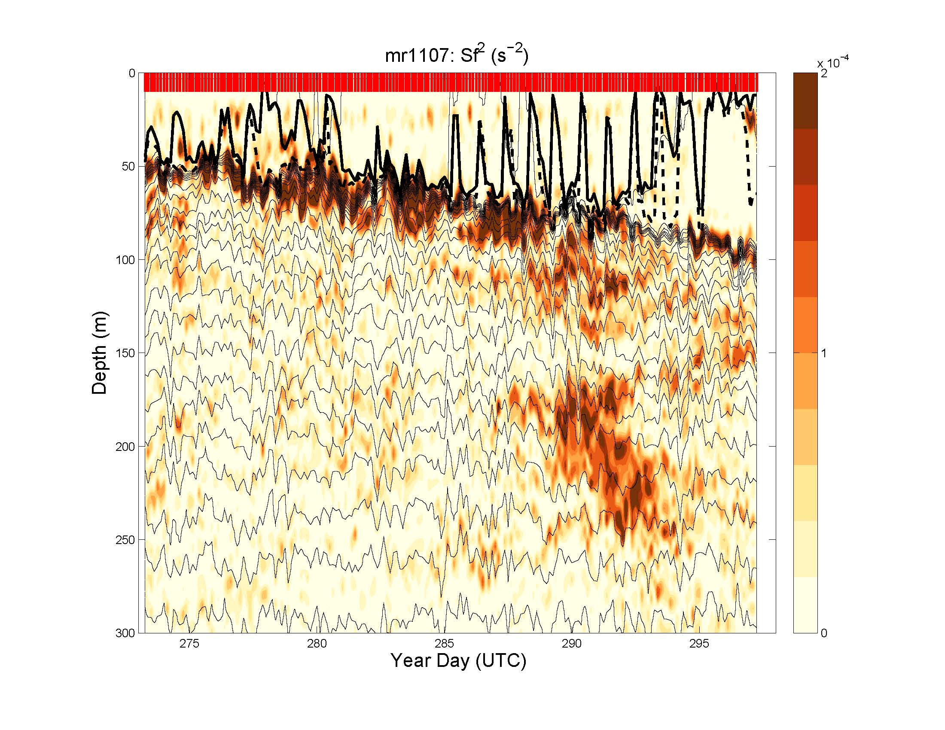

Slide 18
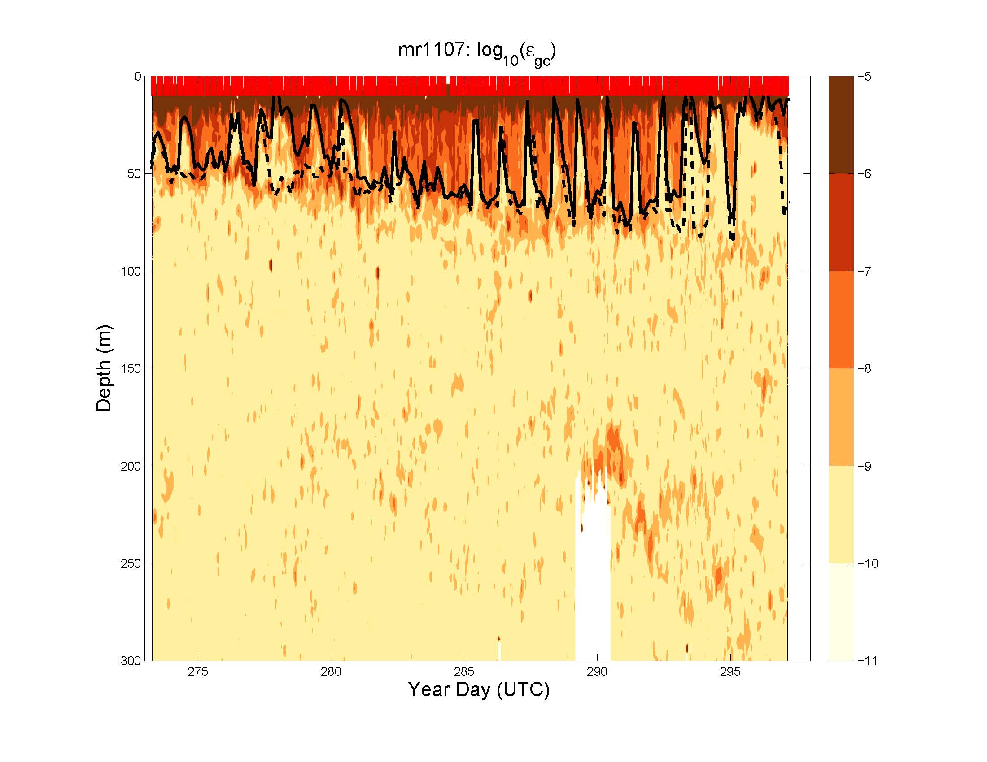

Slide 19
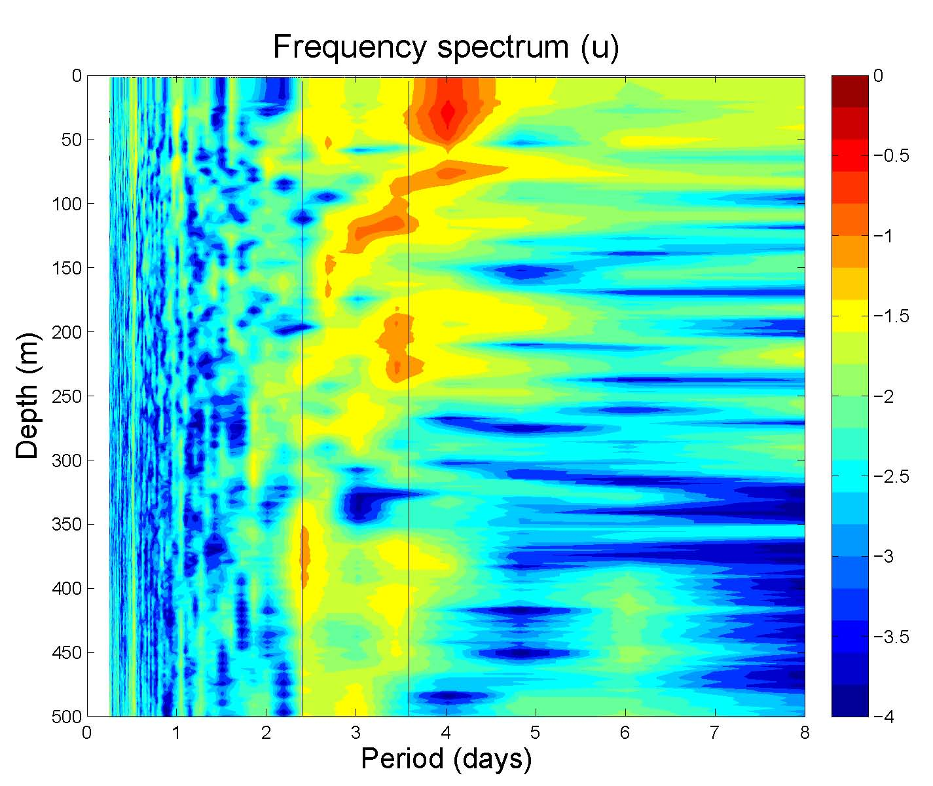

Slide 20
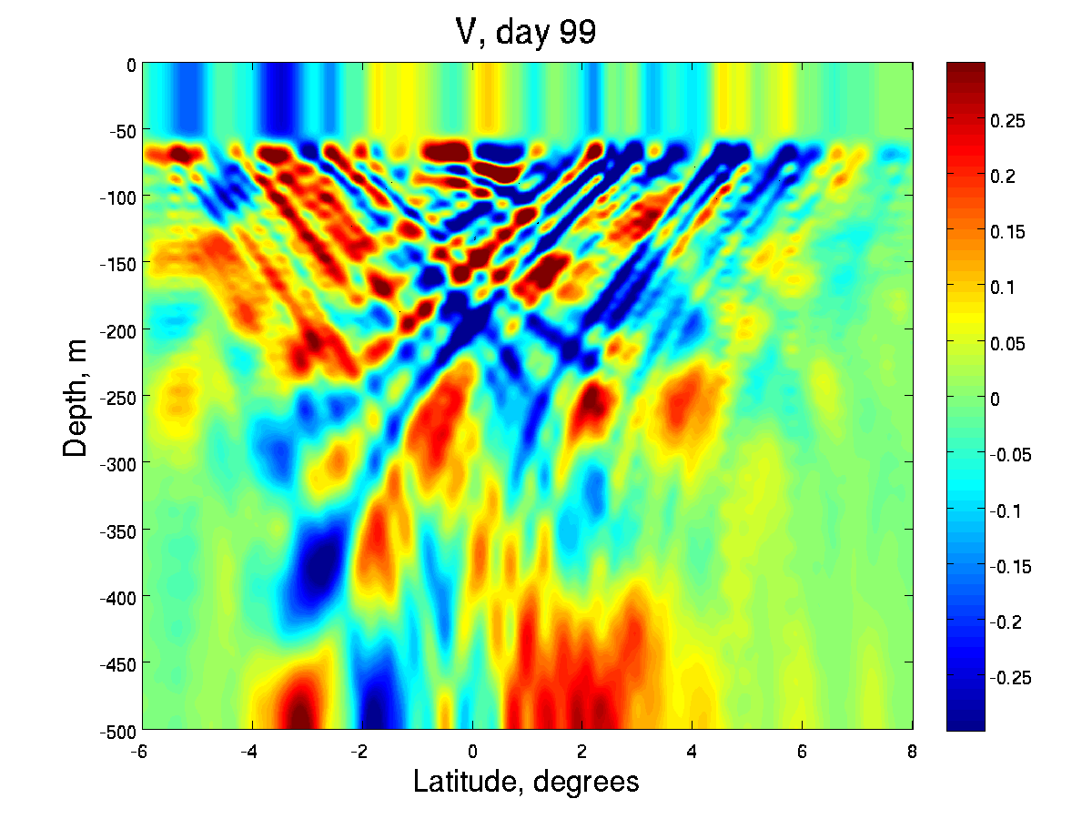
Linear model forced with QuikSCAT along 156E
0m
500m
6S
8N

Slide 21
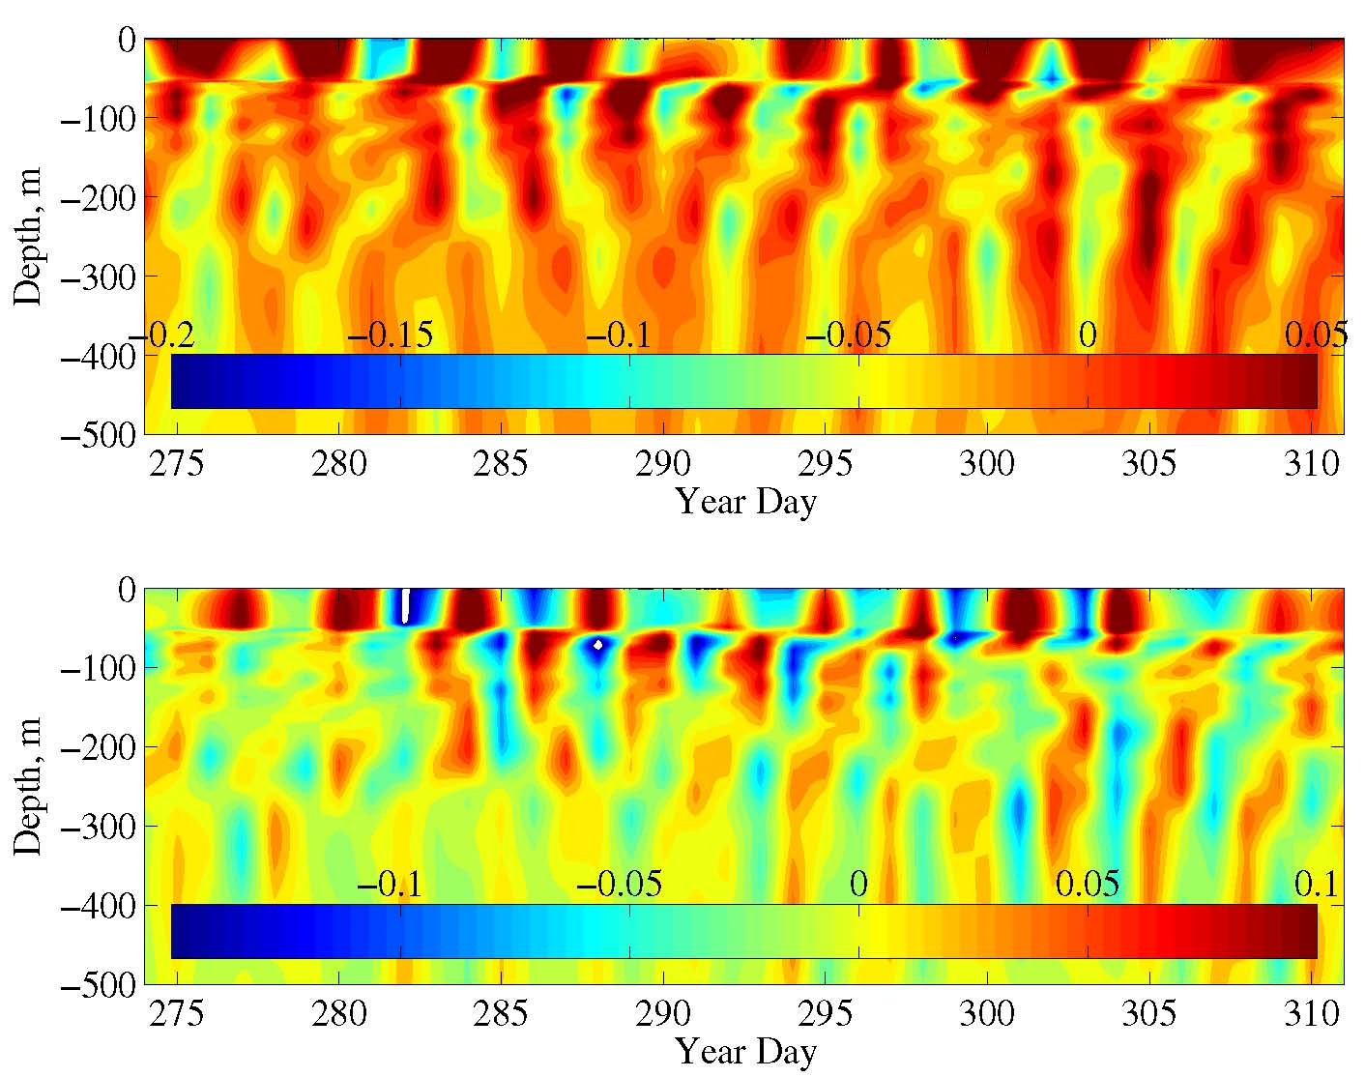

Slide 23
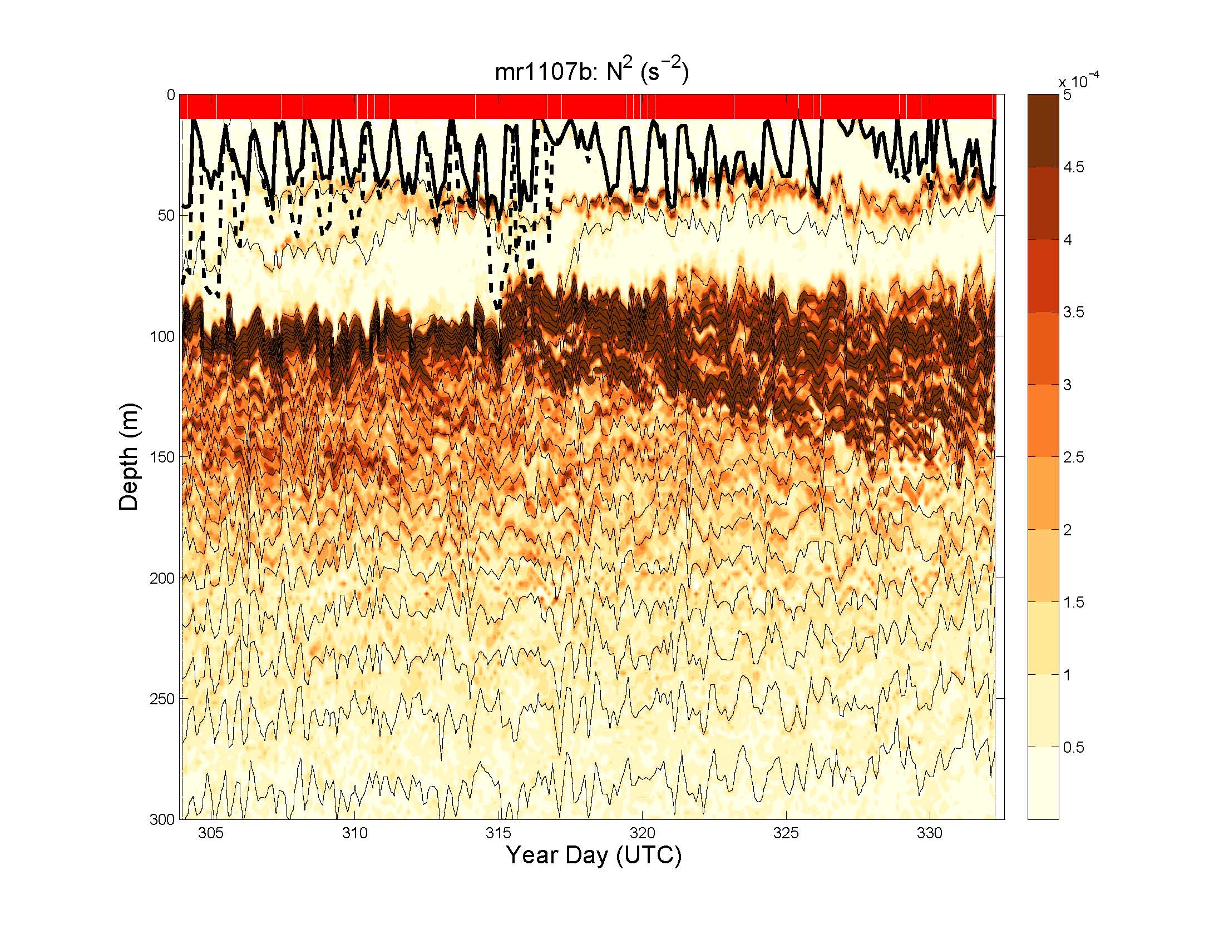

Slide 24
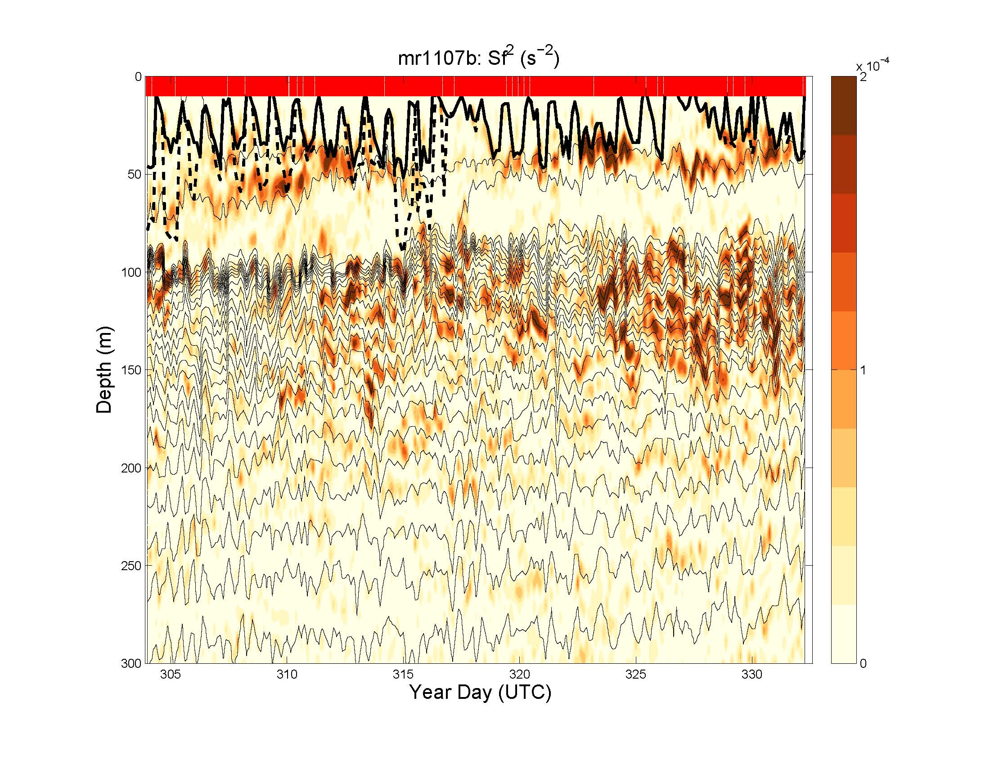

Slide 25
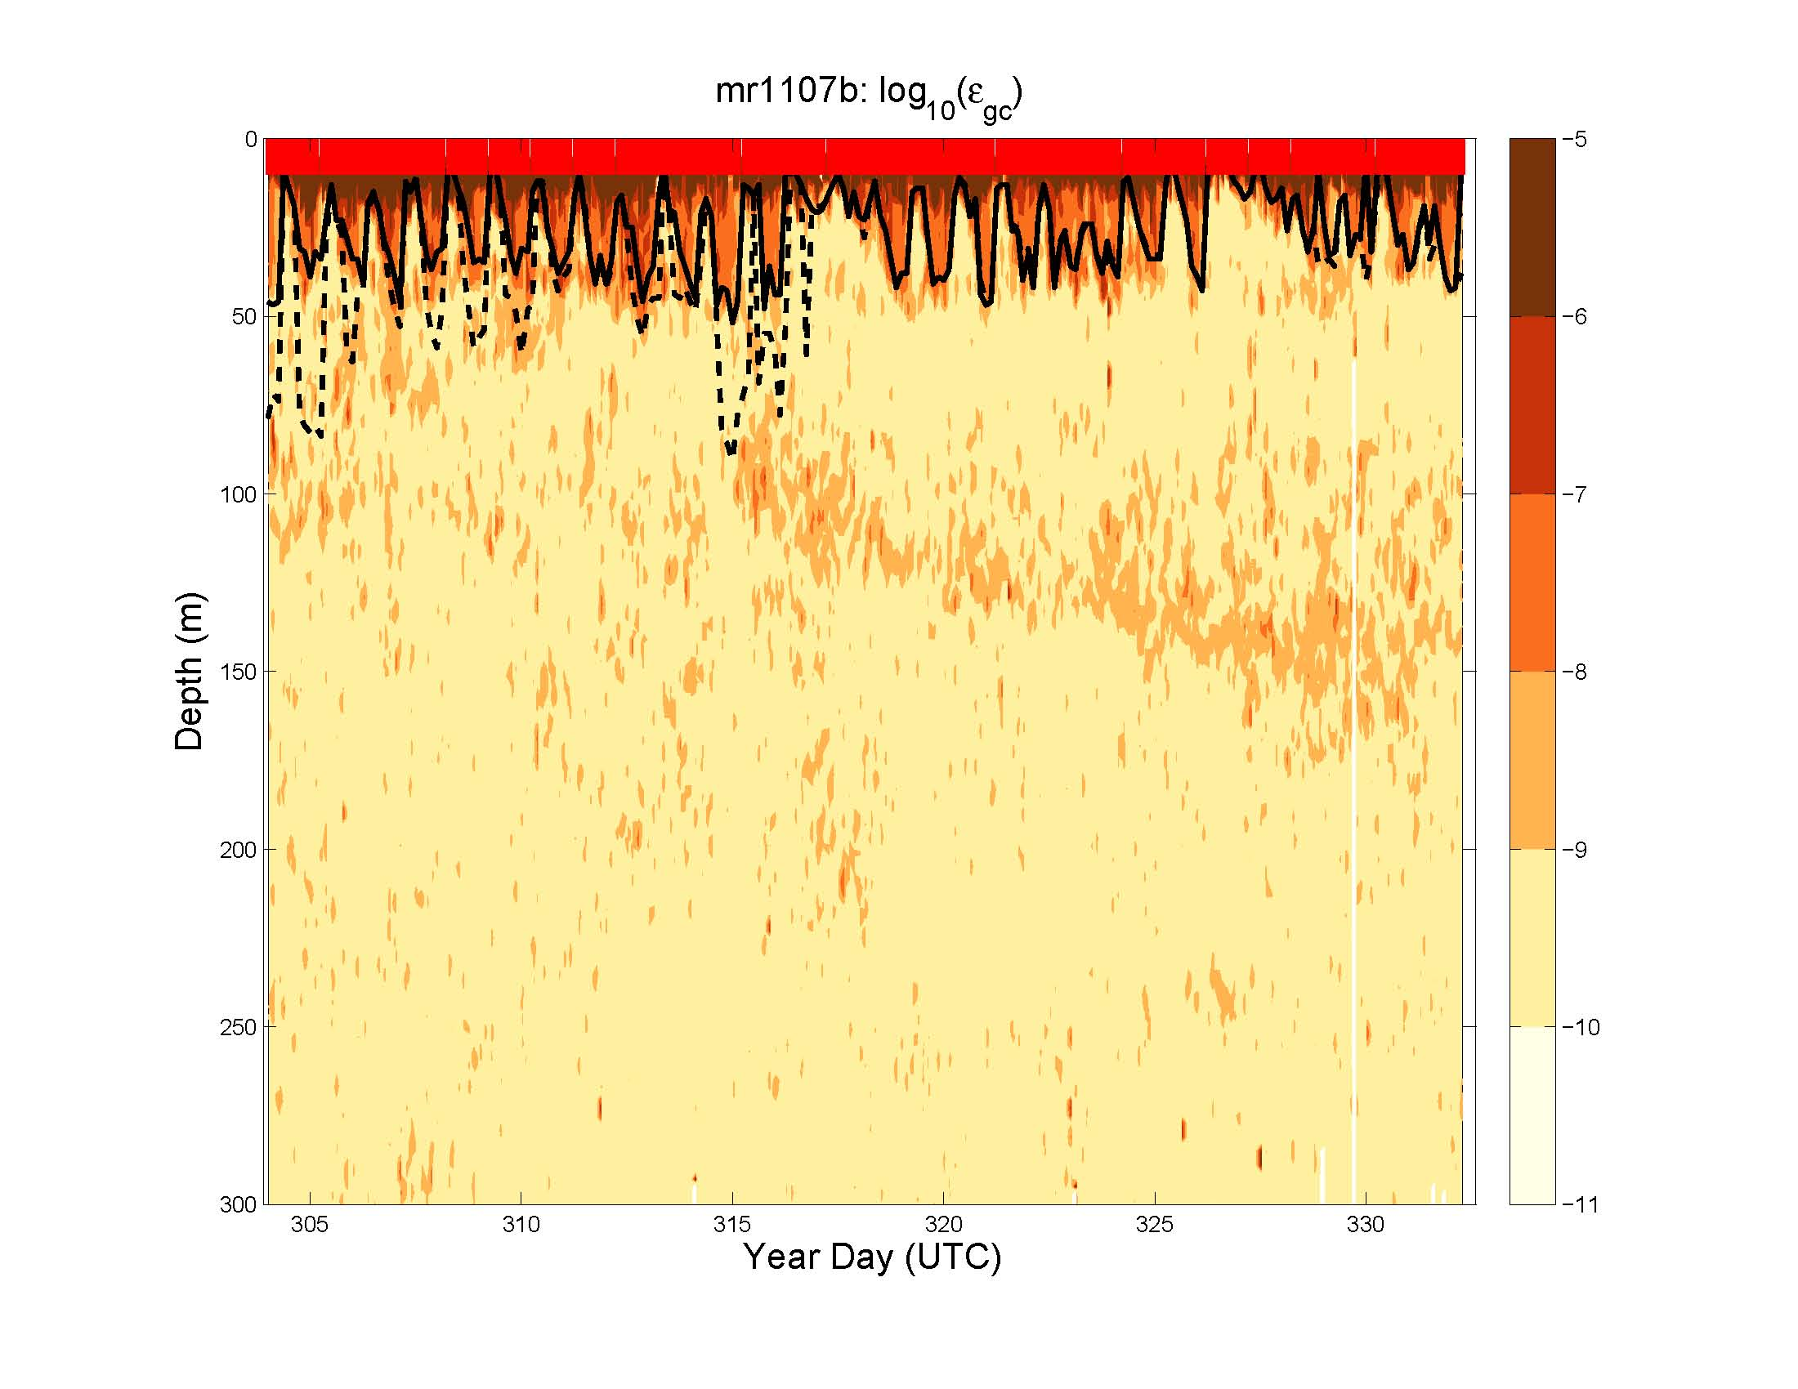

Slide 26
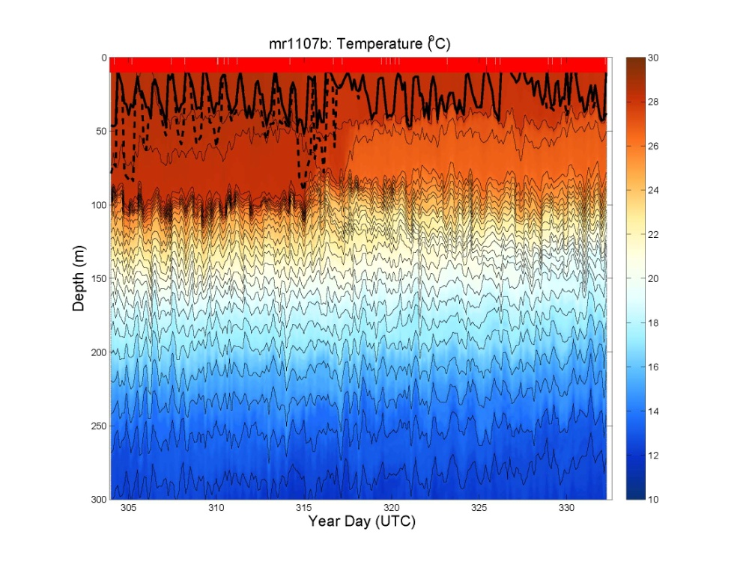
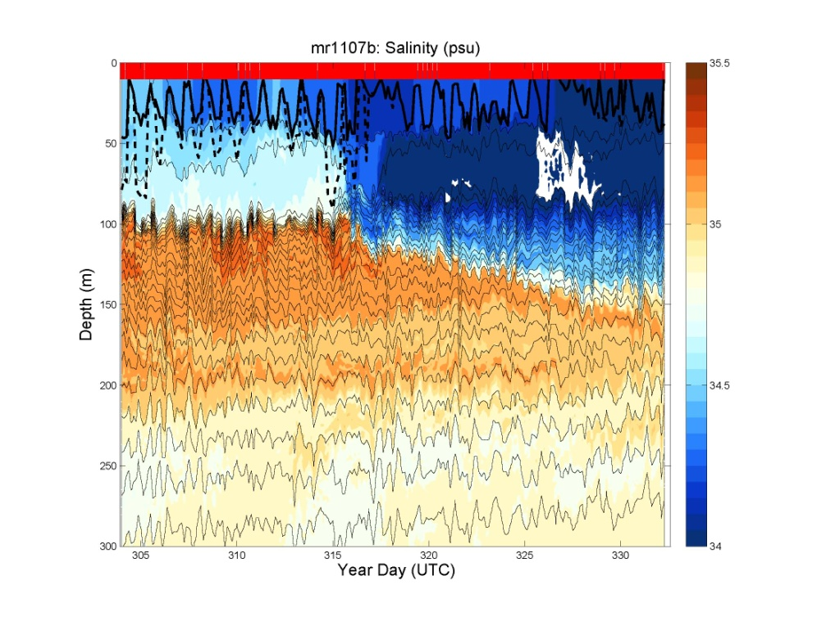

Slide 27
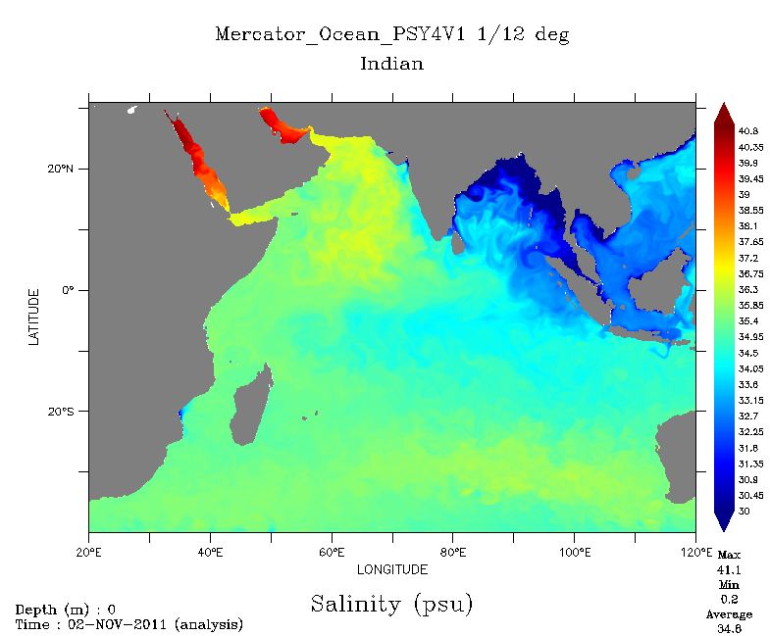
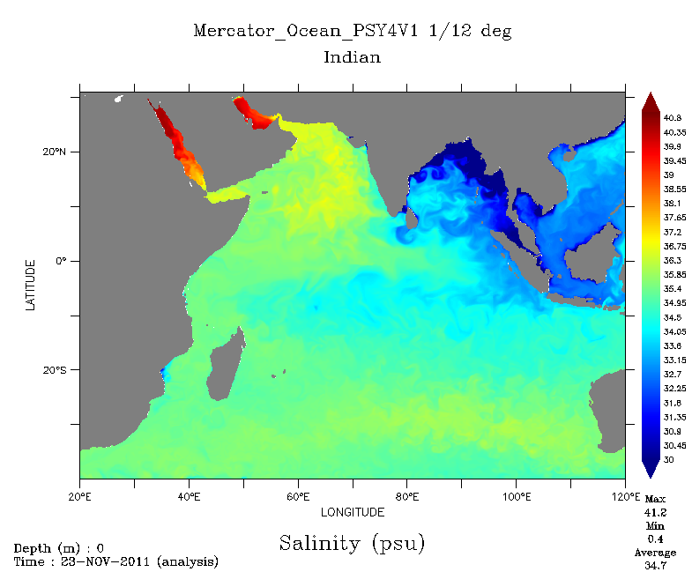
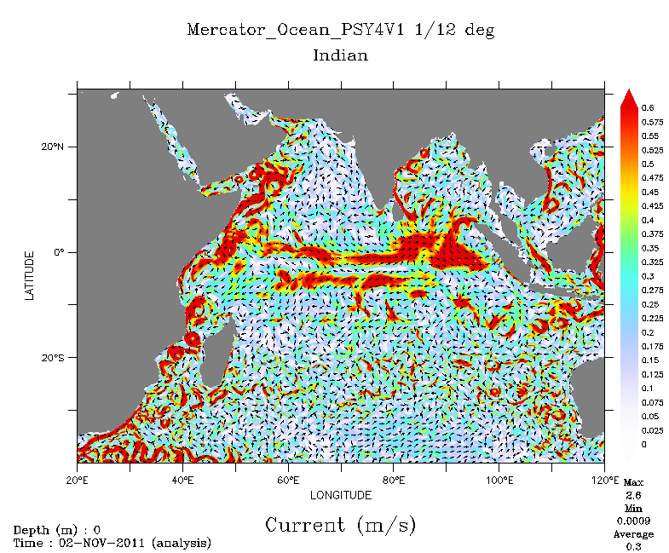
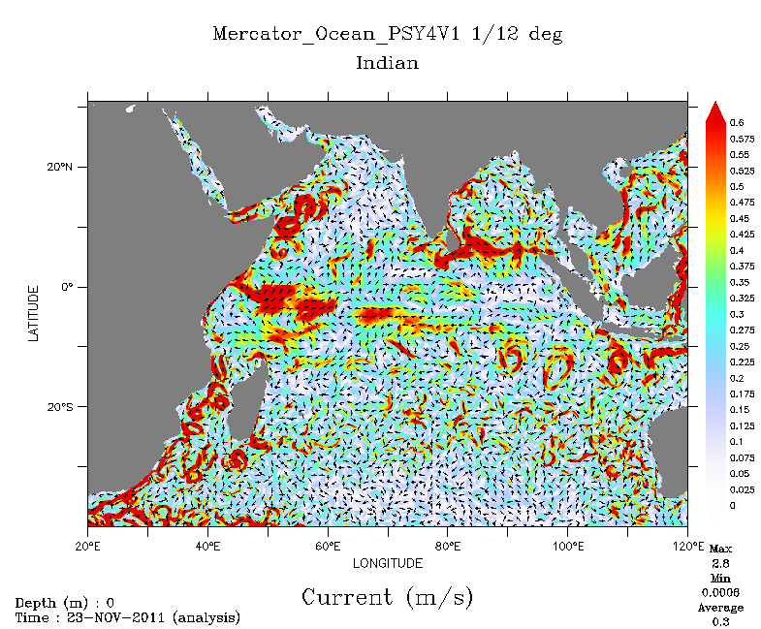
2 Nov 2011
23 Nov 2011

Slide 28
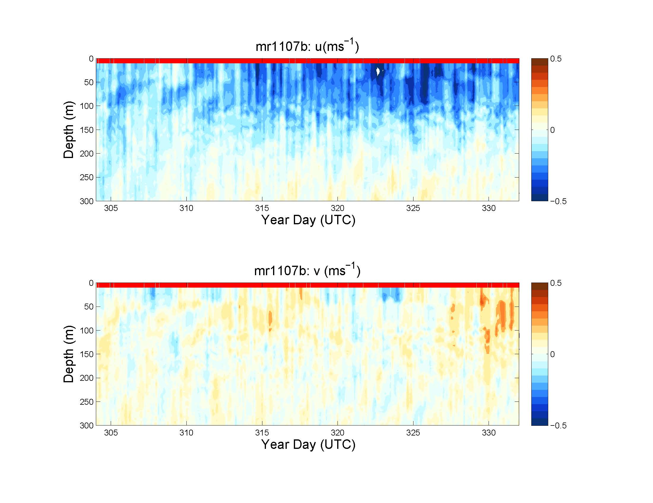

Slide 29
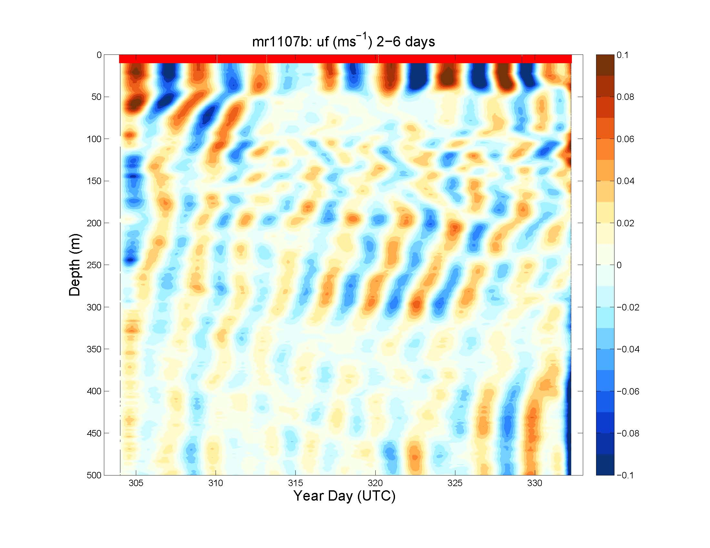

Slide 30
