Slide 1
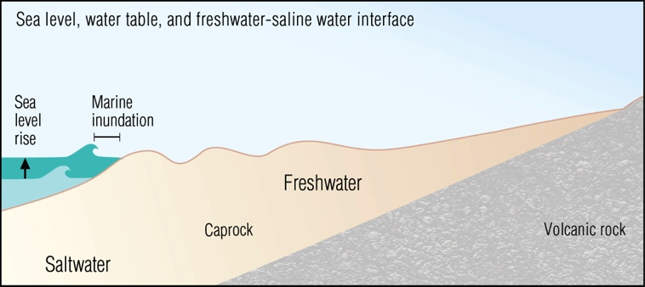
Groundwater Inundation & Rainfall
Precipitation
Lack of infiltration space
Backflow / lack of drainage
Rotzoll, K., and Fletcher, C. 2013, Assessment of groundwater inundation as a consequence of sea-level rise. Nature Climate Science
Notes:
So this underground body of water will rise and break out in especially low lying areas, and otherwise reduce the unsaturated zone.

Slide 2
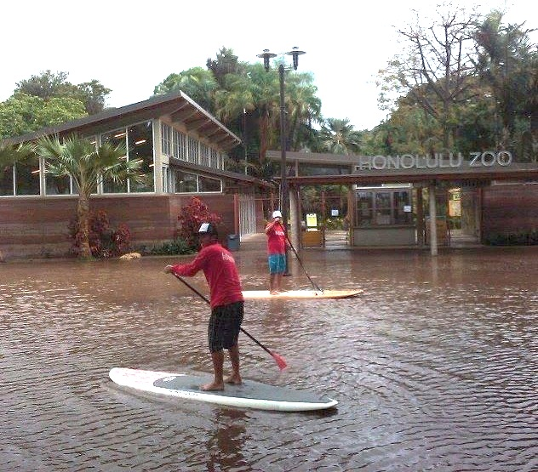
Modeling Groundwater and Rainfall under higher sea levels
Model multiple SLR scenarios (up to ~1m)
For each future sea level, model a range of historic rainfall events:
  Mild, Moderate, Extreme
Outcomes:
  Map locations where rainfall events cause flooding
    Identify vulnerable infrastructure
  Investigate flood frequency under higher sea levels
    How will combinations of future SLR & rainfall compare to present-day flood levels?
    Will mild/moderate rainfall events in the future (with SLR) → flood levels that are considered extreme today?

