Slide 2
Precipitation & SLR
Rainfall can infiltrate into pervious soil
Finite capacity to absorb water
When precipitation rate exceeds infiltration capacity, there is overland flow
Lack of drainage for rainfall
Strom drain backflow from ocean
Increased ponding due to higher groundwater table and reduced infiltration space

Slide 3
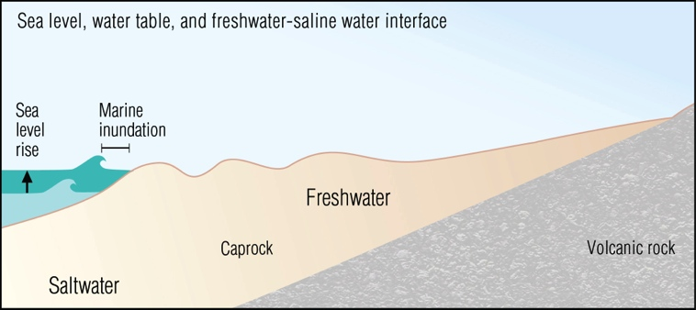
Groundwater Inundation & Rainfall
Precipitation
Lack of infiltration space
Backflow / lack of drainage
Rotzoll, K., and Fletcher, C. 2013, Assessment of groundwater inundation as a consequence of sea-level rise. Nature Climate Science
Notes:
So this underground body of water will rise and break out in especially low lying areas, and otherwise reduce the unsaturated zone.

Slide 4
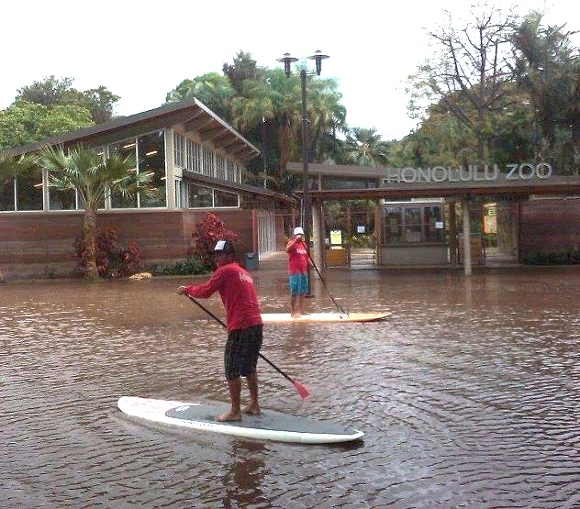
Modeling Groundwater and Rainfall under higher sea levels
Model multiple SLR scenarios (up to ~1m)
For each future sea level, model a range of historic rainfall events:
Mild, Moderate, Extreme
Outcomes:
Map locations where rainfall events cause flooding
Identify vulnerable infrastructure
Investigate flood frequency under higher sea levels
How will combinations of future SLR & rainfall compare to present-day flood levels?
Will mild/moderate rainfall events in the future (with SLR) → flood levels that are considered extreme today?

